Slide 1

Module 2
Multi-Class Classification
Notes:
Guidelines
Use section headers to chunk content in your presentation.
Use the same style of section header throughout your presentation.
Keep your title to no more than 2 lines.

Slide 2
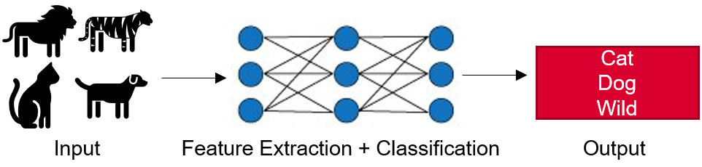
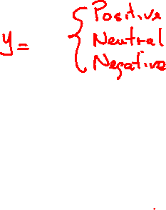
Multi-Class Classification
Notes:
Guidelines
Use a title slide at the beginning of your presentation. There are 9 variations of title slides to choose from.
If you will have a series of slideshows, we recommend using the same style of title slide for each presentation.
Keep your title to no more than 2 lines.
Do not change the font style or font size of the title or subtitle.

Slide 3
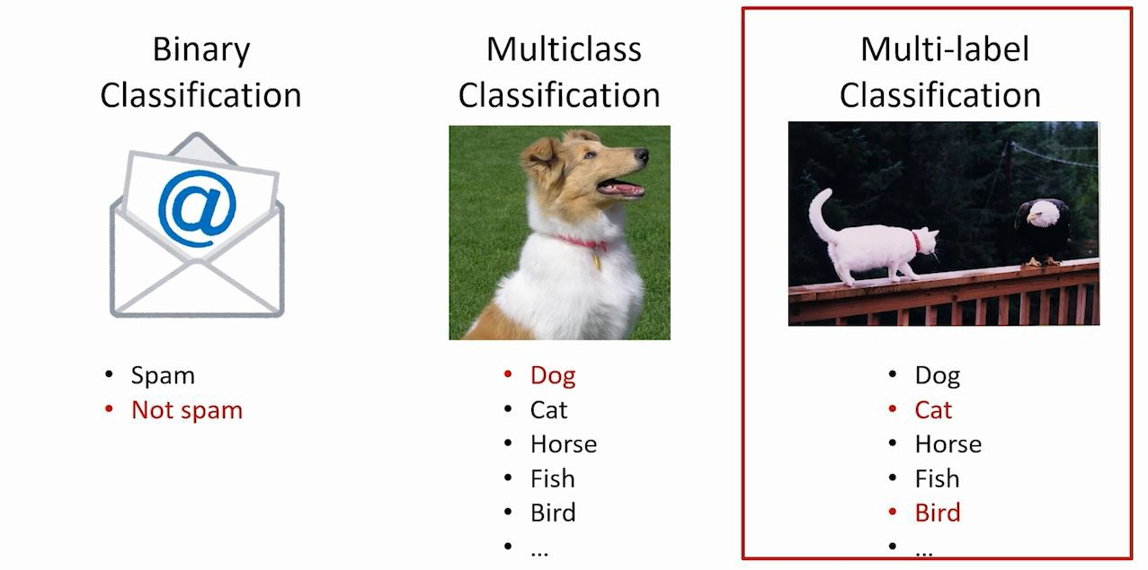
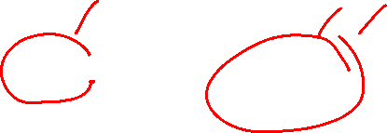
Types of Classification Problems
The 3 main classification problems are:

Slide 4
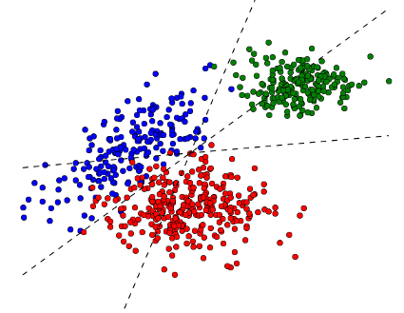
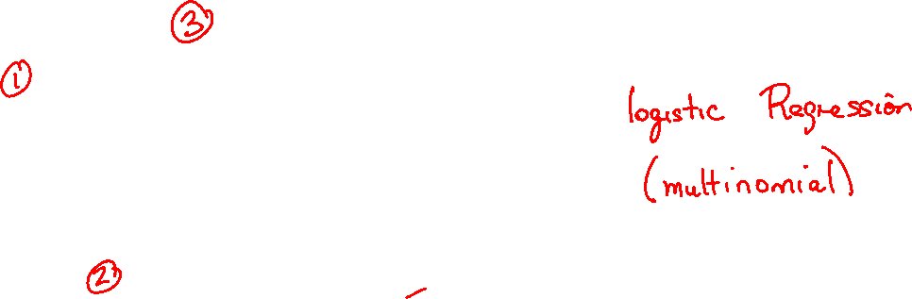
Multi-Class Classification
is a classification task with more than two classes.
Separating Hyperplanes
LINEAR

Slide 5
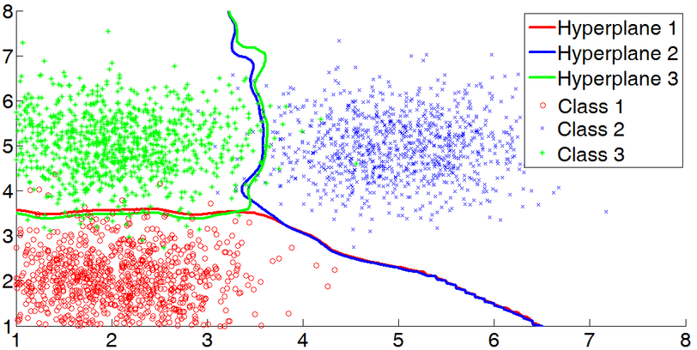
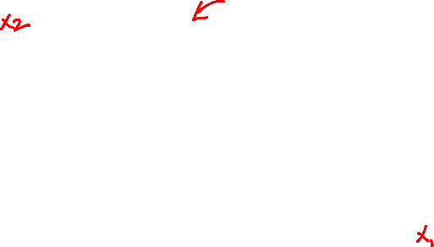
Multi-Class Classification
is a classification task with more than two classes.
Separating Hyperplanes
NON-LINEAR

Slide 6
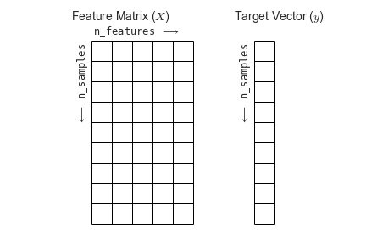
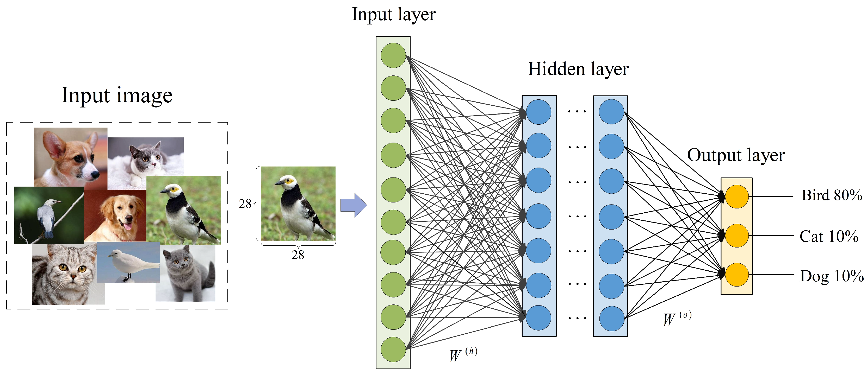
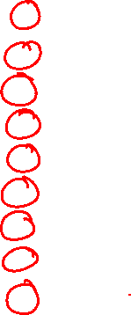
Multi-Class Classification
1
1
3
2
1
3
3
1
2

Slide 7
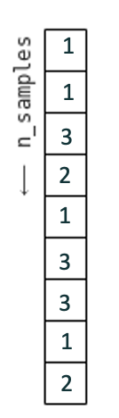

Multi-Class Classification
1
1
0
0
1
0
0
1
0

Slide 8

Multi-Class Classification
0
0
0
1
0
0
0
0
1

Slide 9
Multi-Class Classification
0
0
1
0
0
1
1
0
0

Slide 10
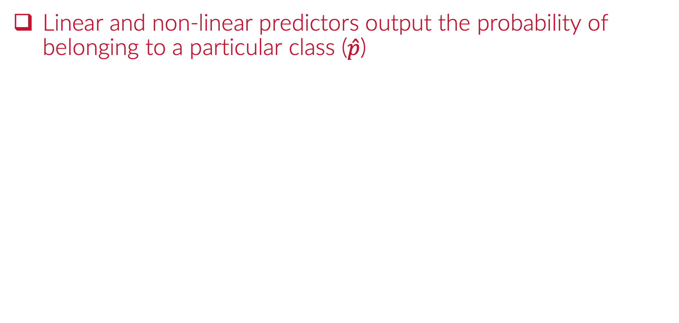
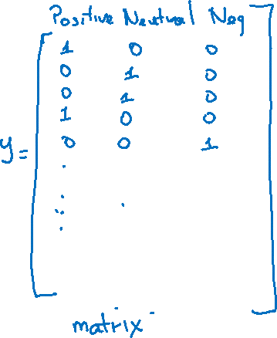
Multi-Class Classification - Propensities
Linear and non-linear predictors output the probability of belonging to a particular class ($\hat{p}$)

Slide 11
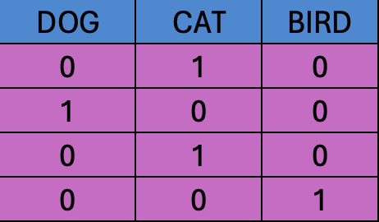
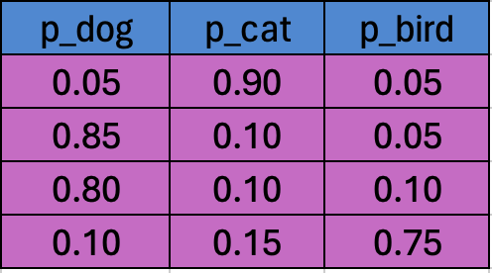
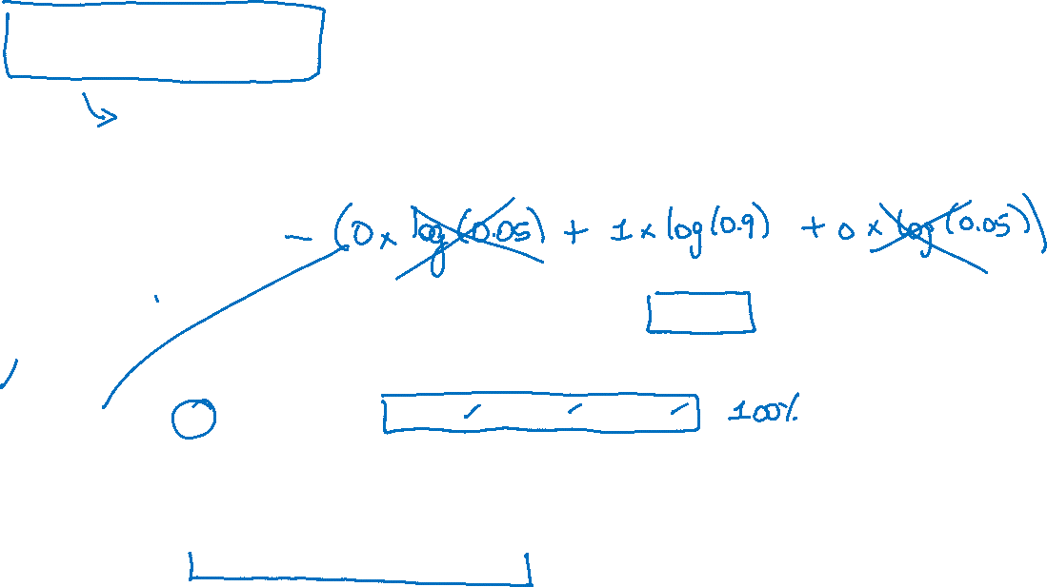
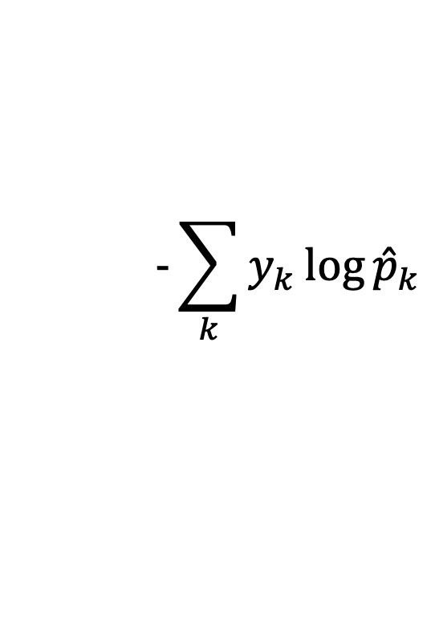
Categorical Cross-Entropy
The most common loss function in multi-class classification
$$−\sum_{k}{y_{k}}\log{{\hat{p}}_{k}}$$
How do we determine the distance between this two matrices?

Slide 12
Categorical Cross-Entropy
The most common loss function in multi-class classification
$$−\sum_{k}{y_{k}}\log{{\hat{p}}_{k}}$$
$$−\left(0 \log{0.05}+1\log{0.90}+0\log{0.05}\right)=0.1054$$

Slide 13
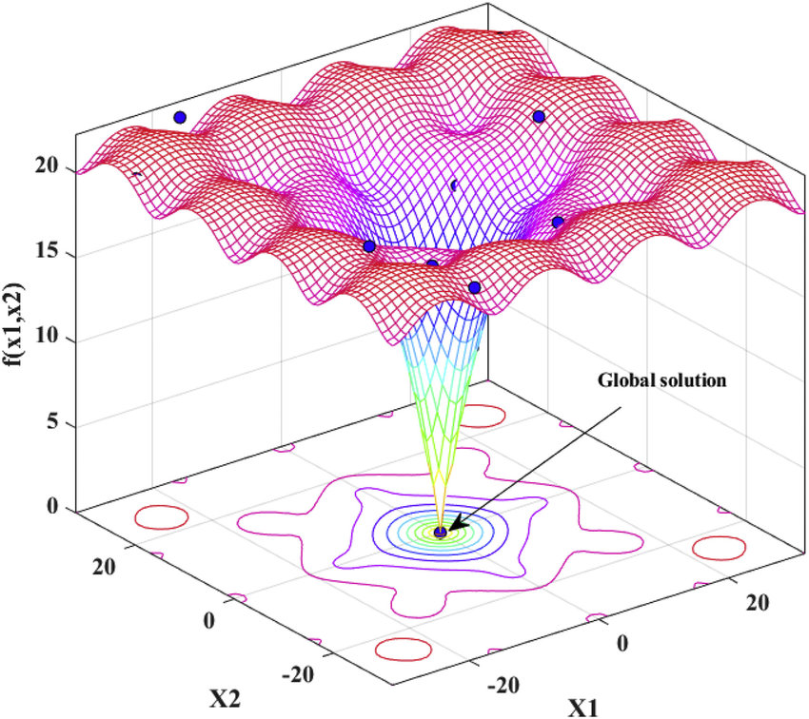

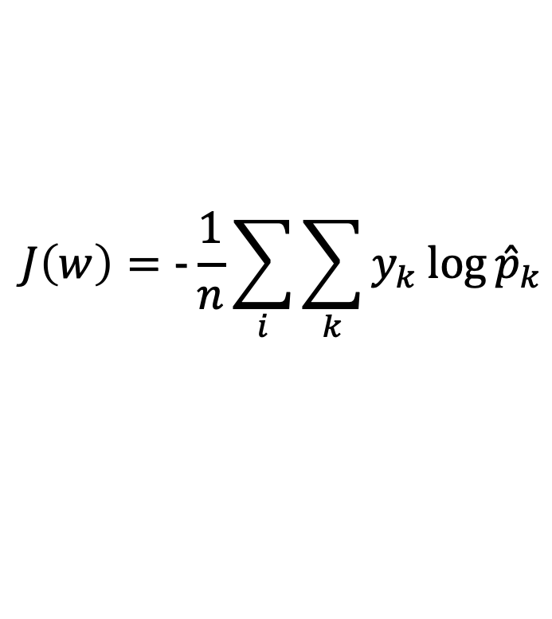
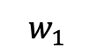
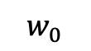
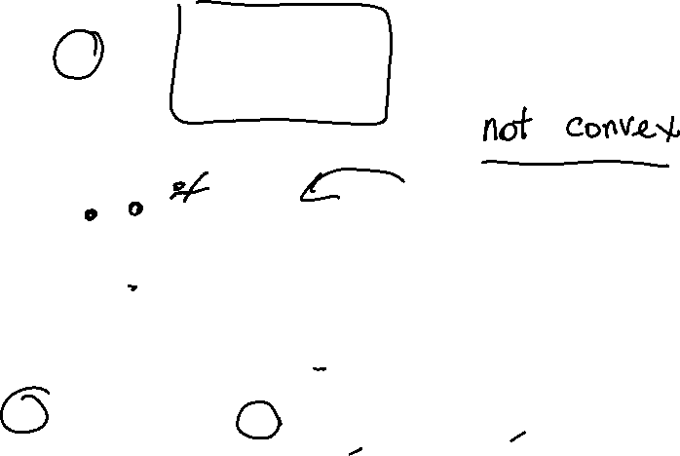
Categorical Cross-Entropy
The cost function is averaged over the observations
$$J\left(w\right)=−\frac{1}{n}\sum_{i}{\sum_{k}{y_{k}}\log{{\hat{p}}_{k}}}$$
$$J(w)$$
$$w_{0}$$
$$w_{1}$$

Slide 14
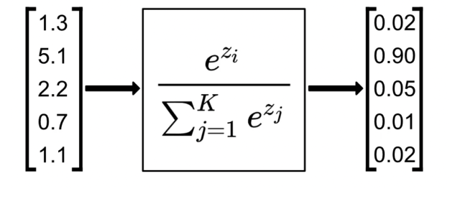
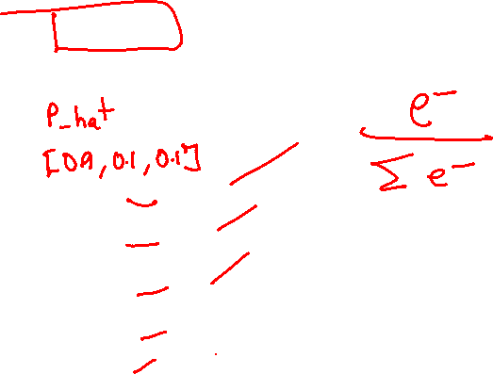
Combining Predictions
We use the softmax function to combine predictions

Slide 15
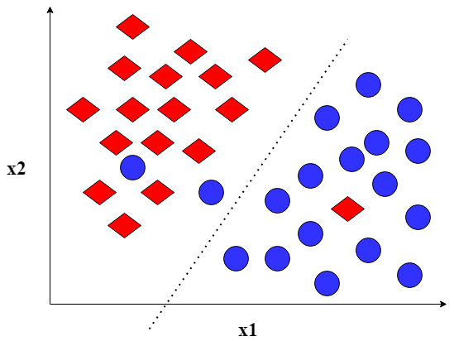
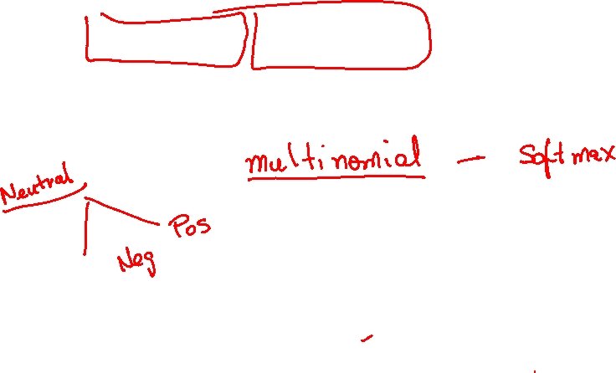
Binary Classification Algorithms?
We can still use binary classification algorithms in multi-class classification
Strategies: One-Vs-All (One-Vs-Rest) and One-Vs-One
Example: LOGISTIC REGRESSION
$$\hat{p}= \frac{1}{1+ e^{−(w_{0}+w_{1}x_{1}+ ….)}}=\frac{1}{1+ e^{Xw}}$$

Slide 16
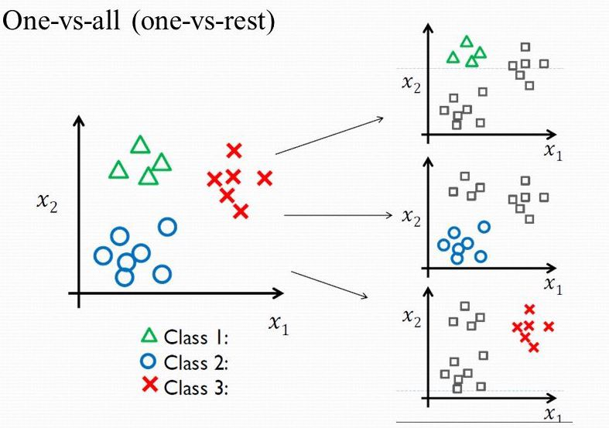
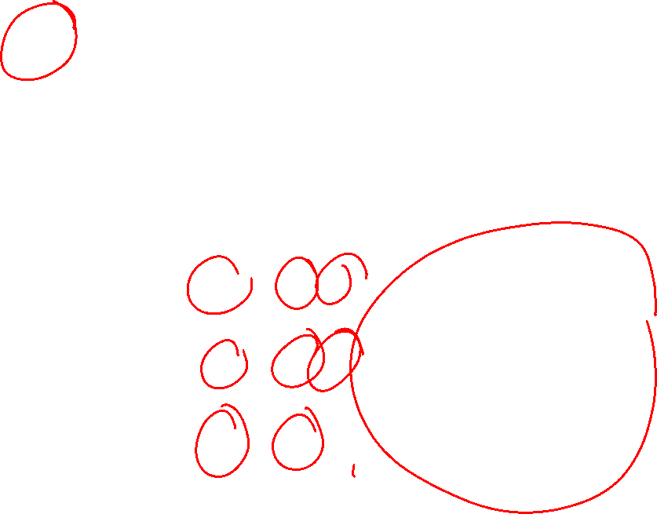
One-Vs-All (One-Vs-Rest)
This approach implies fitting the model multiple times
In each fit the binary classifier compares one class against the rest
$$\hat{p}= \frac{1}{1+ e^{−(w_{0}+w_{1}x_{1}+ ….)}}=\frac{1}{1+ e^{Xw}}$$
VS
VS
$$\hat{p}= \frac{1}{1+ e^{−(w_{0}+w_{1}x_{1}+ ….)}}=\frac{1}{1+ e^{Xw}}$$
$$\hat{p}= \frac{1}{1+ e^{−(w_{0}+w_{1}x_{1}+ ….)}}=\frac{1}{1+ e^{Xw}}$$
VS

Slide 17
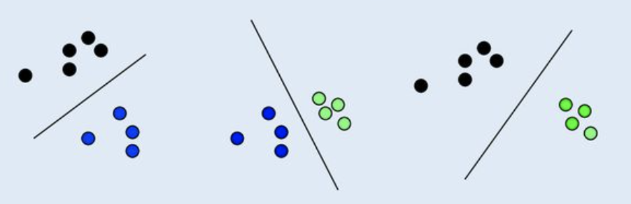
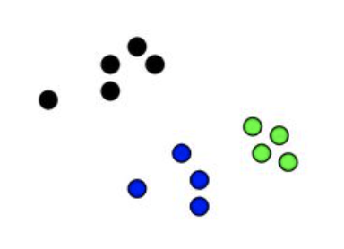
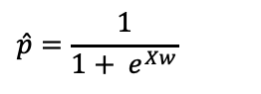
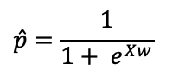
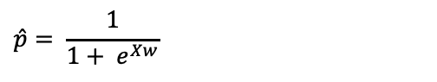
One-Vs-One
This approach implies fitting the model multiple times
In each fit the binary classifier compares one class against each other class
VS
VS
VS
$$\hat{p}= \frac{1}{1+ e^{Xw}}$$
$$\hat{p}=\frac{1}{1+ e^{Xw}}$$
$$\hat{p}=\frac{1}{1+ e^{Xw}}$$

Slide 18
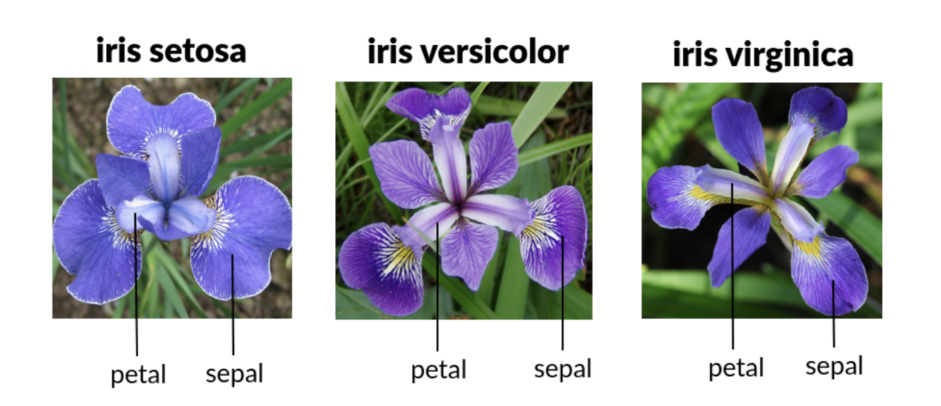

IRIS Dataset
Classical ML dataset

Slide 19
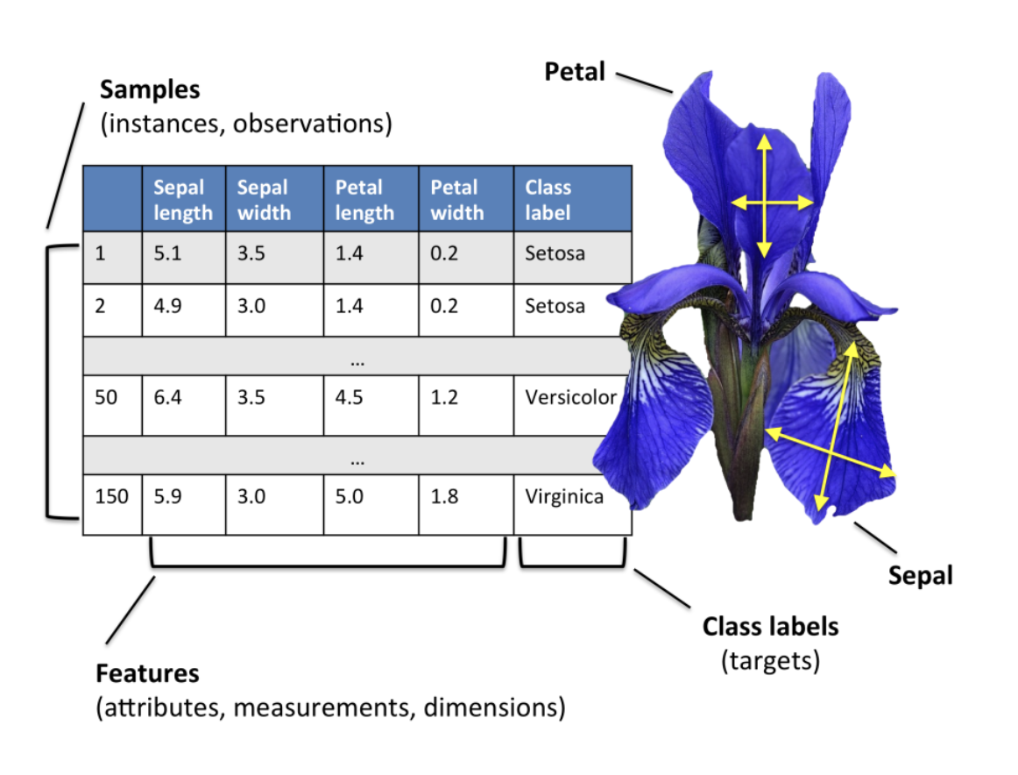
IRIS Dataset
Classical ML dataset

Slide 20
Python
Notes:
Guidelines
Use a title slide at the beginning of your presentation. There are 9 variations of title slides to choose from.
If you will have a series of slideshows, we recommend using the same style of title slide for each presentation.
Keep your title to no more than 2 lines.
Do not change the font style or font size of the title or subtitle.

Slide 21
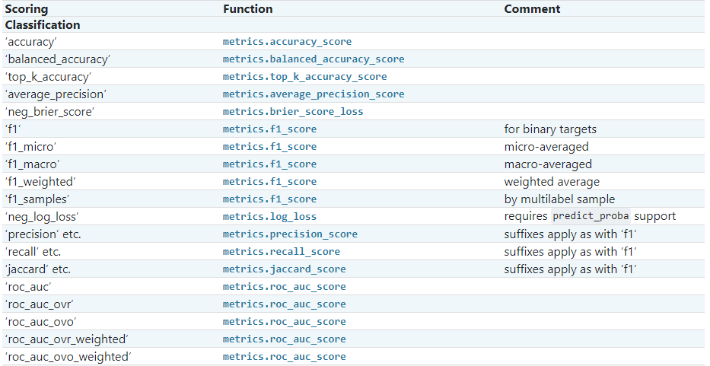
Metrics
Used to determine if model is performing well

Slide 22
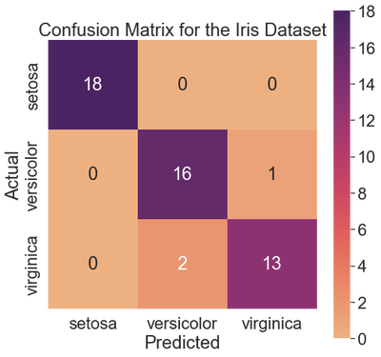
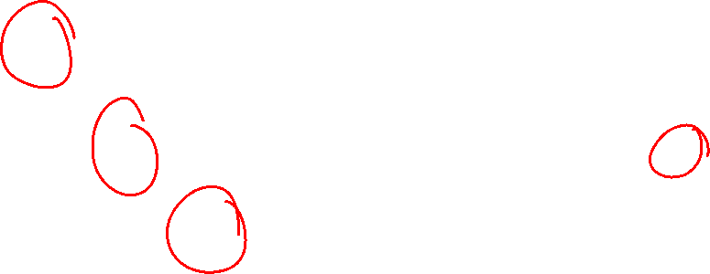
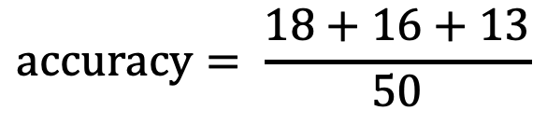
Metrics Review: Confusion Matrix
The confusion matrix gives a summary of overall performance
Accuracy can be derived as the fraction of correct predictions
$$accuracy= \frac{18+16+13}{50}$$

Slide 23
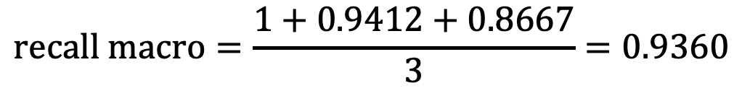
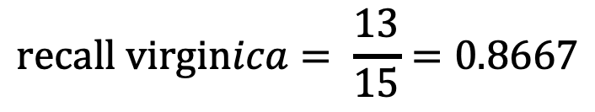
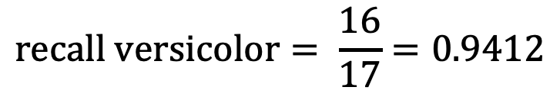
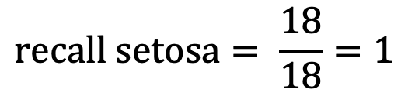
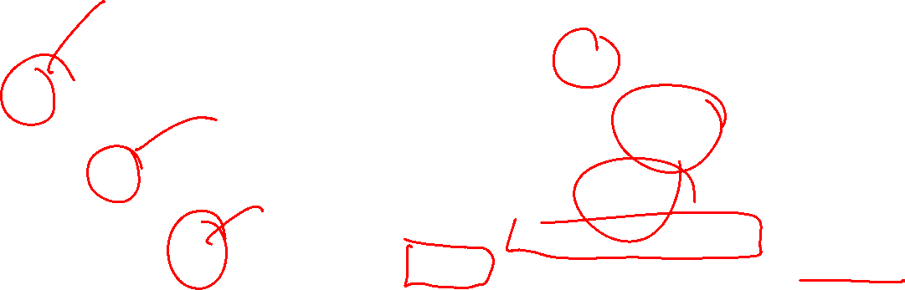
Metrics Review: Recall (Sensitivity)
Detection rate for all classes
We can use macro average (average by the number of classes).
$$recall setosa= \frac{18}{18}=1$$
$$recall versicolor= \frac{16}{17}=0.9412$$
$$recall virginica= \frac{13}{15}=0.8667$$
$$recall macro=\frac{1+0.9412+0.8667}{3}=0.9360$$

Slide 24

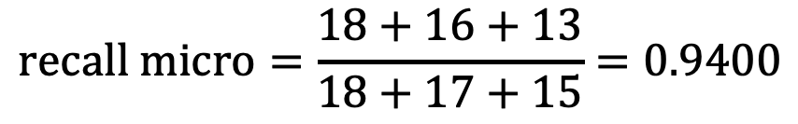
Metrics Review: Recall (Sensitivity)
Detection rate for all classes
We can use micro average (sum true detections over all obs).
$$recall micro=\frac{18+16+13}{18+17+15}=0.9400$$

Slide 25
Python
Notes:
Guidelines
Use a title slide at the beginning of your presentation. There are 9 variations of title slides to choose from.
If you will have a series of slideshows, we recommend using the same style of title slide for each presentation.
Keep your title to no more than 2 lines.
Do not change the font style or font size of the title or subtitle.

Slide 26
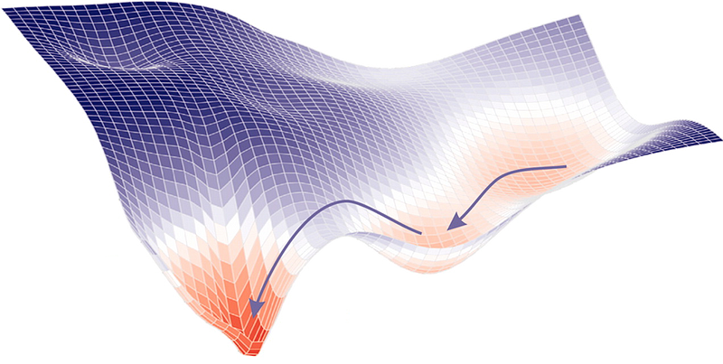
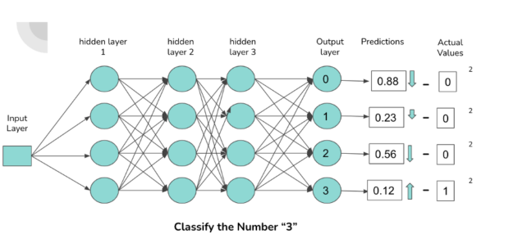
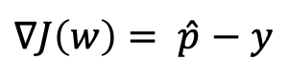
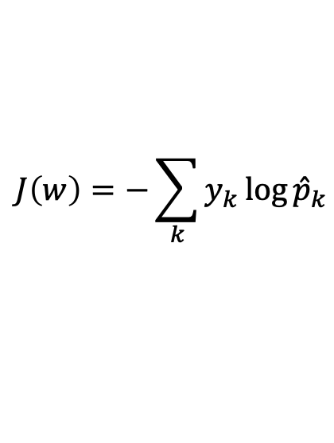


Common Cost Functions Neural Nets
Categorical Cross-Entropy
Loss Function
Gradient
$$J\left(w\right)=−\sum_{k}{y_{k}}\log{{\hat{p}}_{k}}$$
$\hat{p}$
$∇J\left(w\right)= \hat{p}$ $− y$

Slide 27


Activation Functions Neural Nets
Common Activations on Layers
ReLu
Tanh
Sigmoid
Output Layer Activation
Softmax
$\hat{p}$

Slide 28
Python
Notes:
Guidelines
Use a title slide at the beginning of your presentation. There are 9 variations of title slides to choose from.
If you will have a series of slideshows, we recommend using the same style of title slide for each presentation.
Keep your title to no more than 2 lines.
Do not change the font style or font size of the title or subtitle.

